Slide 1

Snake Game with BFS
This presentation documents a simple Snake Game with a GUI using Python's tkinter library. The game integrates an intelligent feature where the snake automatically navigates toward the food using the Breadth-First Search (BFS) algorithm to determine the shortest path. The GUI is designed to be user-friendly, with added visual and functional elements to enhance gameplay.

Slide 2
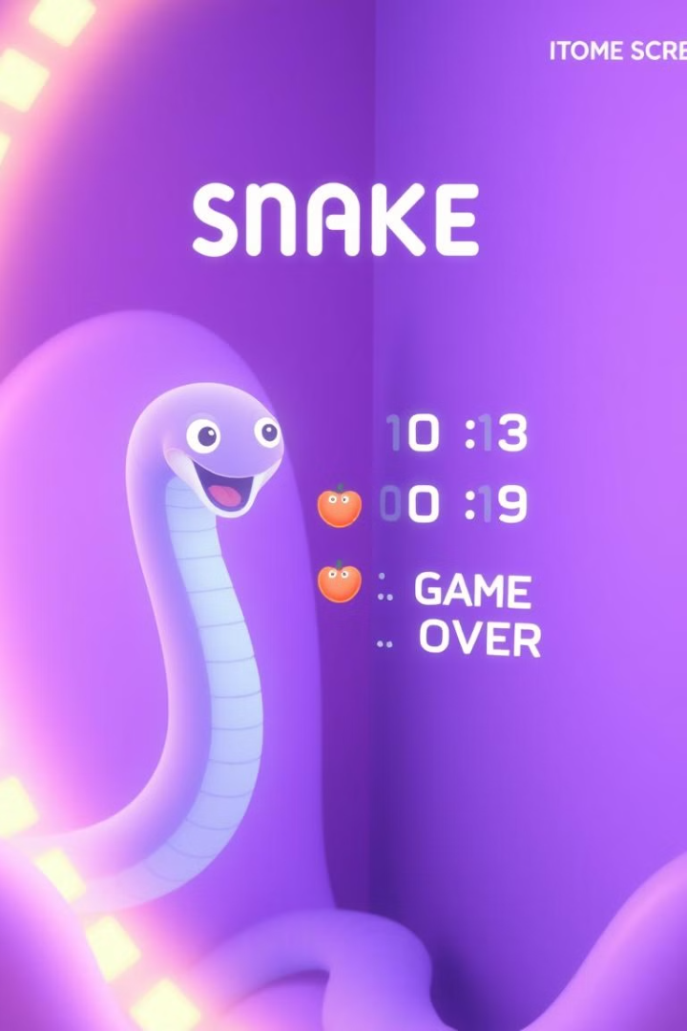
Key Features
Automatic Pathfinding
Dynamic Gameplay
The snake grows as it consumes food, increasing the difficulty.
The snake uses BFS to find the shortest path to the food.
Score Tracking
Game Over Display
A real-time score display is updated as the player progresses.
The game provides a clear notification when the player loses.

Slide 3
Code Structure
Constants
Class: SnakeGame
The primary class that handles game logic, rendering, and user interactions.
Grid Dimensions: grid_size, cell_size, grid_width, and grid_height define the game board's size.
Directions: A dictionary maps movement commands (UP, DOWN, LEFT, RIGHT) to coordinate changes.

Slide 4
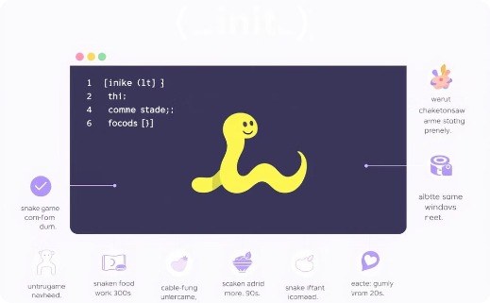
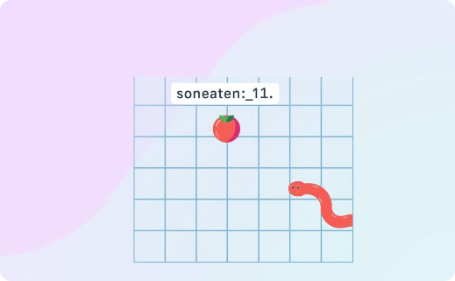
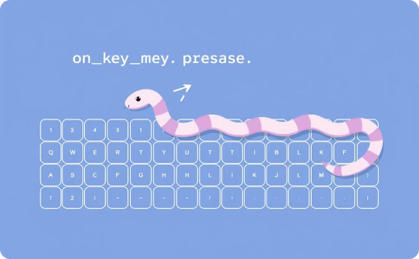
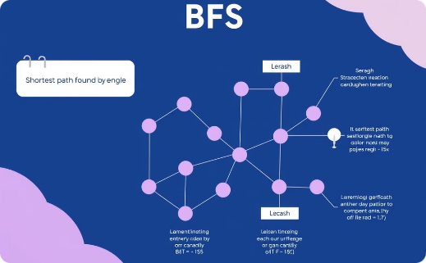
Key Methods
__init__
generate_food
Initializes the game.
Places food randomly.
on_key_press
bfs
Handles user input.
Finds the shortest path using BFS.

Slide 5
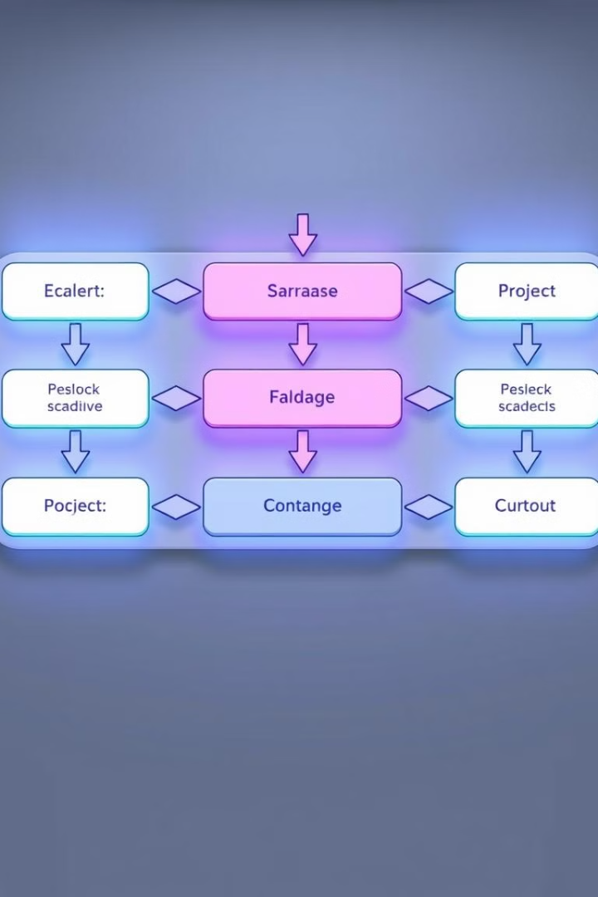
Game Logic
1
Movement
The snake's movement is controlled by the direction set in self.direction, which is updated via user input (KeyPress events) and BFS pathfinding.
2
Collision Detection
The game ends if the snake's head moves outside the grid (wall collision) or overlaps with any part of its body (self-collision).
3
Food Consumption
When the snake reaches the food, it grows by not removing its tail, a new food position is generated, the score is incremented, and the score is displayed in the GUI.

Slide 6
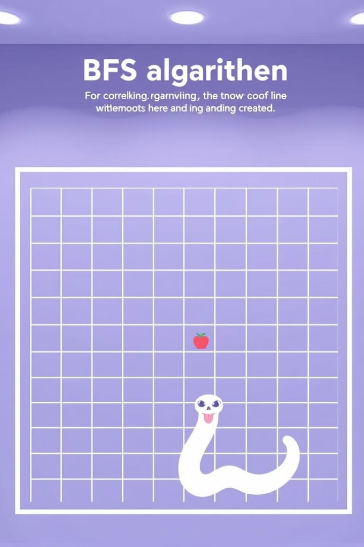
Pathfinding with BFS
BFS explores all possible movements from the snake's head, ensuring no movement crosses into the snake's body or outside the grid. It returns the shortest path to the food, guiding the snake step-by-step.

Slide 7



User Interface (GUI)
Frame
Score Label
Canvas
The main container holding all game elements.
Displays the player's current score at the top of the frame.
Where the snake and food are visually rendered against a dark background.

Slide 8
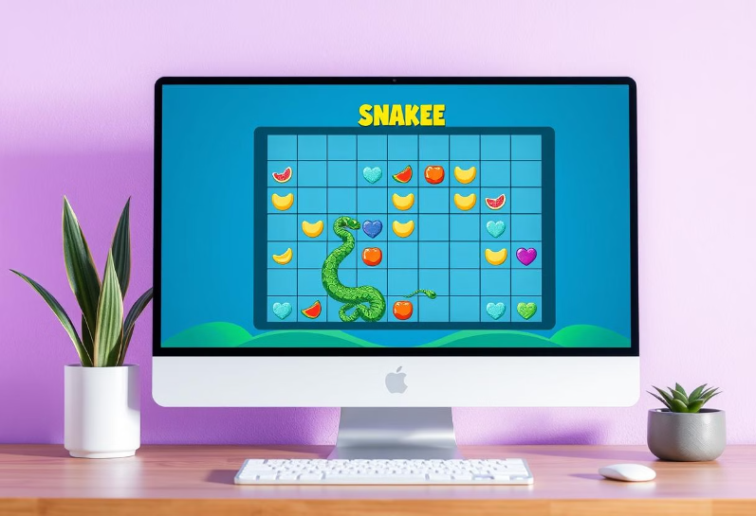
Conclusion
This Snake Game successfully integrates AI pathfinding with an engaging GUI. The BFS algorithm ensures intelligent snake navigation, while the tkinter interface provides a smooth user experience. This project serves as a strong foundation for more advanced games and simulations.

Slide 9
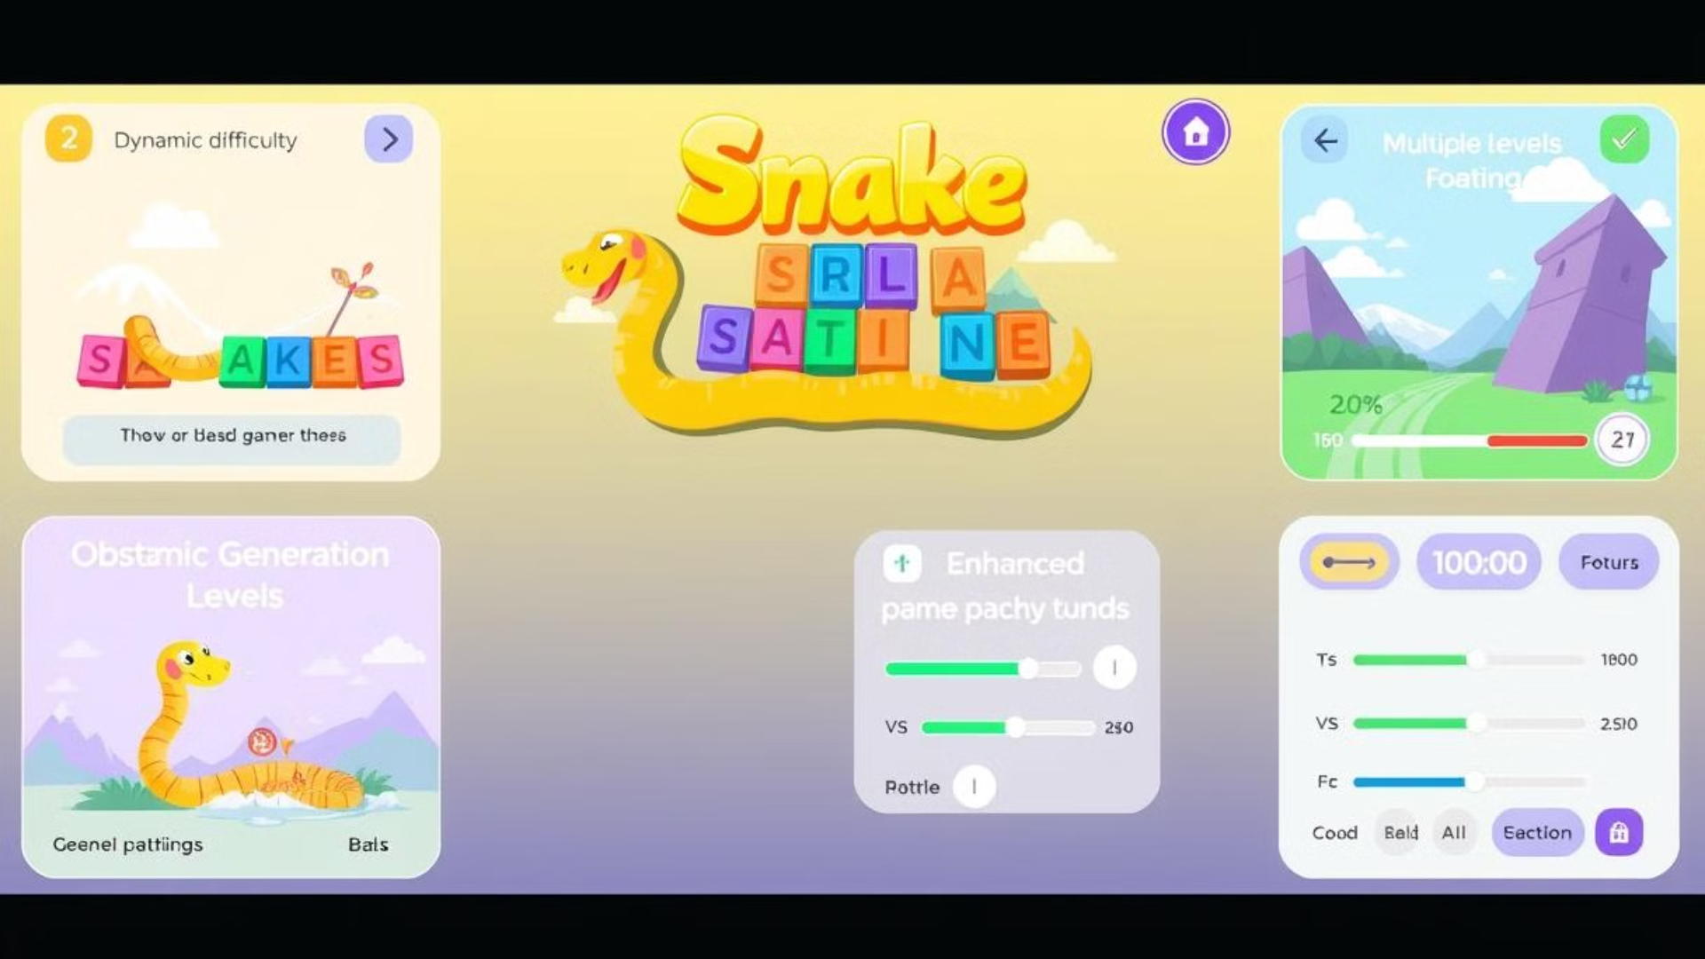
Future Improvements
Dynamic Difficulty
Obstacle Generation
Increase speed as the score increases.
Add obstacles to make the game more challenging.
Multiple Levels
Enhanced Pathfinding
Create different levels with unique layouts.
Use A* or other algorithms for more efficient navigation.
Customizable Settings
Allow users to adjust grid size, speed, and colors.

Slide 10
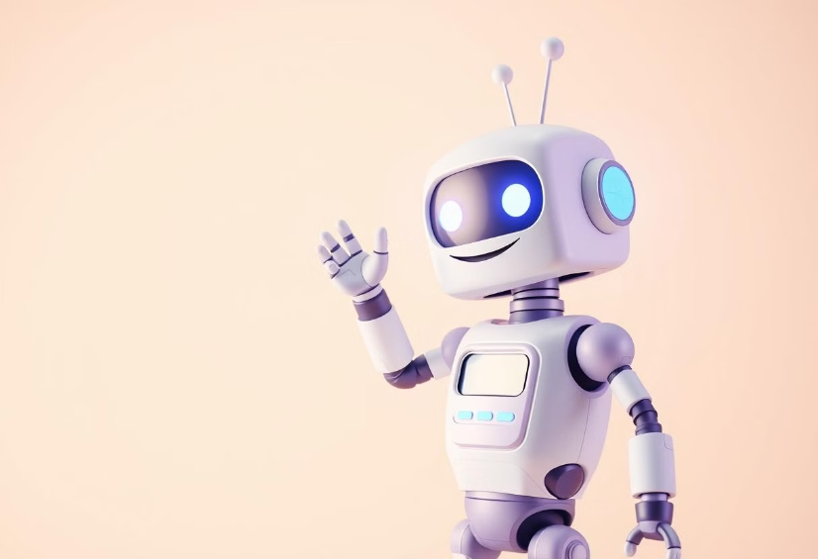
Thank You

